Slide 1
Global Context Enhanced Graph Neural Networks for Session-based Recommendation
Ziyang Wang, Wei Wei, Gao Cong, Xiao-Li Li, Xian-Ling Mao, Minghui Qiu
Huazhong University of Science and Technology
School of Computer Engineering, Nanyang Technological University, Singapore
Institute for Infocomm Research, Singapore
School of Computer Science and Technology, Beijing Institute of Technology
Alibaba Group
SIGIR，2020
张钰波
Apr. 02, 2021

Slide 2
Related Work
Method | Algorithm
GRU4Rec(ICLR 2016) | RNN
NARM(CIKM 2017) | RNN + Attention
STAMP(SIGKDD 2018) | Attention
CSRM(SIGIR 2019) | RNN + Memory Network
SR-GNN(AAAI 2019) | GNN + Attention
GC-SAN(IJCAI 2019) | GNN + Attention
Current - Session
RNN-SBRS
Interests & Preferences
Recommendations
Current - Session
GNN-SBRS
Item Transition Pattern
Recommendations

Slide 3
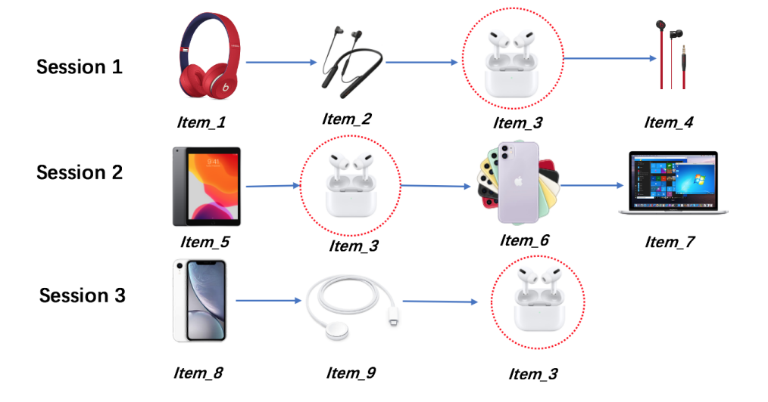
Motivation
Ignoring the useful item-transition patterns from other sessions.
Location information is not considered.

Slide 4
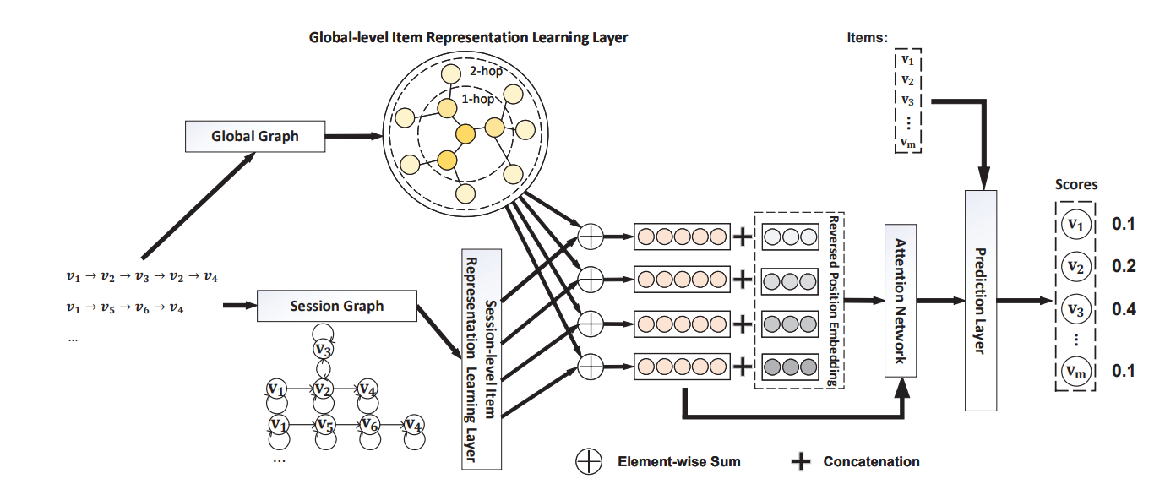
Model
① Global-level Item Representation Learning Layer
④ Prediction Layer
③ Session Representation Learning Layer
② Session-level Item Representation Learning layer

Slide 5
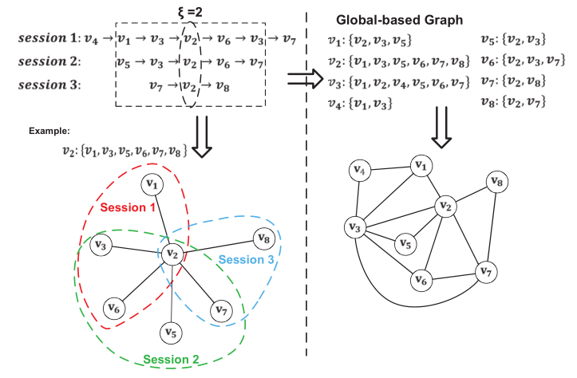
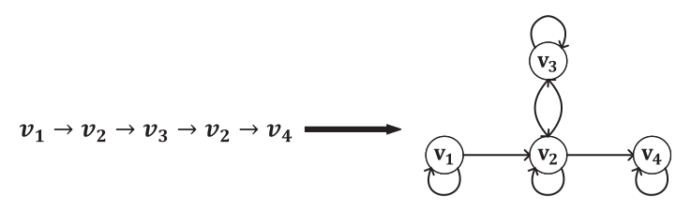
Model
Session Graph，Global Graph
d

Slide 6
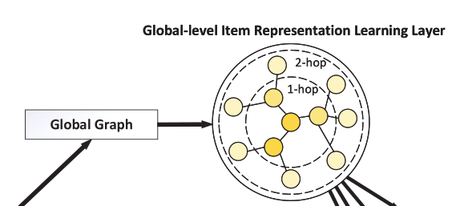
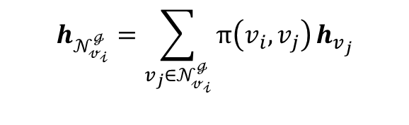

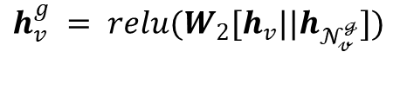
Model
Global-level Item Representation Learning Layer
Information Propagation:
$$h_{𝒩_{𝓋_{𝒾}}^{ℊ}}=\sum_{v_{j}∈𝒩_{𝓋_{𝒾}}^{ℊ}}{π\left(v_{i},v_{j}\right)}h_{v_{j}}$$
$$π\left(v_{i},v_{j}\right)={softmax(q}_{1}^{T} LeakyReLU(W_{1}[(s⊙h_{v_{j}})||w_{ij}])）$$
Information Aggregation:
$$h_{v}^{g} = relu(W_{2}[h_{v}||h_{𝒩_{𝓋}^{ℊ}}])$$
$$h_{v}^{g,\left(k\right)} = agg(h_{v}^{\left(k−1\right)},h_{𝒩_{𝓋}^{ℊ}}^{\left(k−1\right)})$$

Slide 7
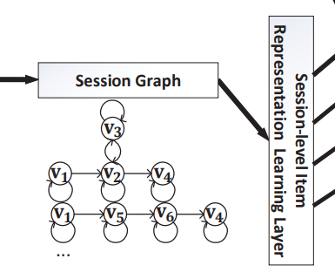
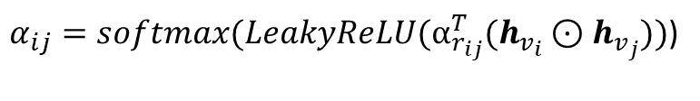
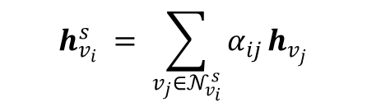
Model
Session-level Item Representation Learning layer
$α_{ij}=softmax(LeakyReLU(α_{r_{ij}}^{T}(h_{v_{i}}⊙h_{v_{j}}))$)
$$h_{v_{i}}^{s} = \sum_{v_{j}∈𝒩_{v_{i}}^{s}}{α_{ij}}h_{v_{j}}$$

Slide 8
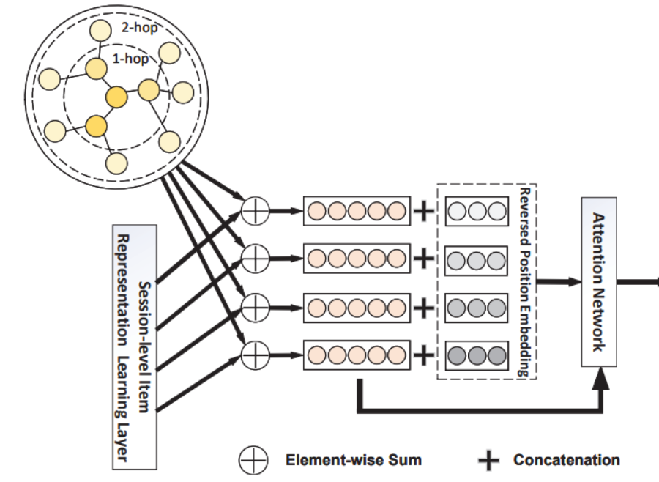
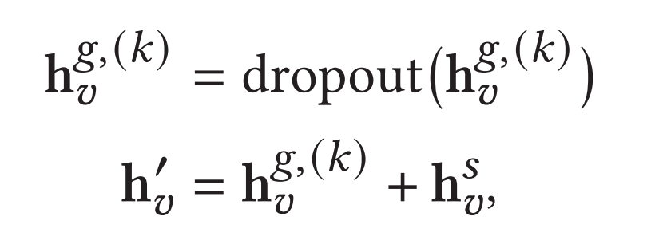
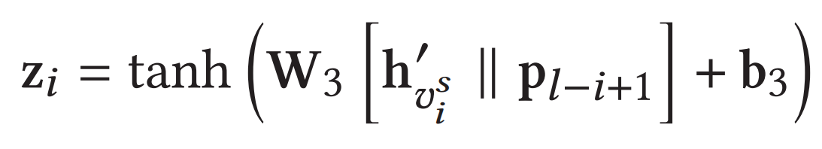
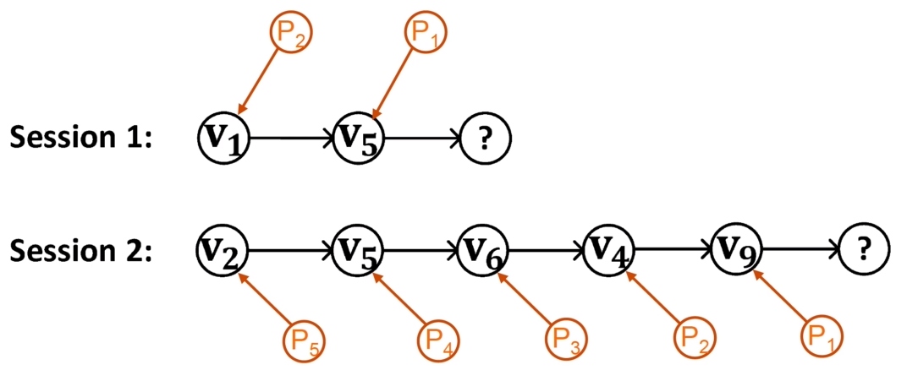
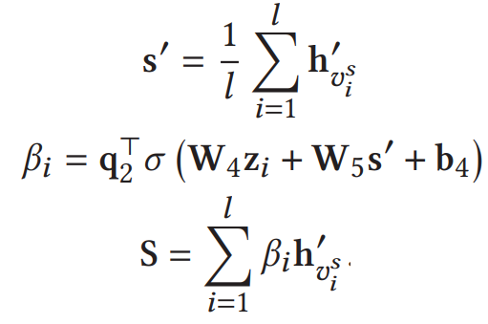
Model
Session Representation Learning Layer

Slide 9
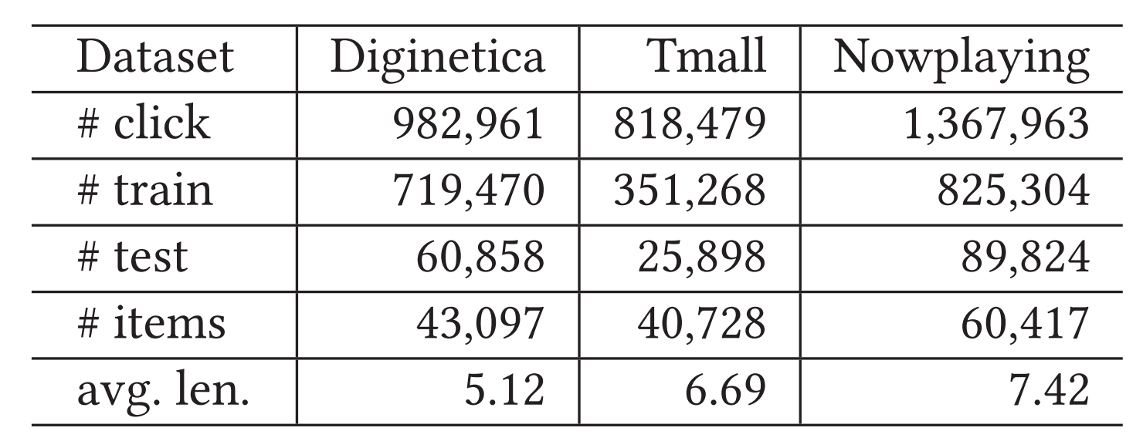
Experiments
Dataset
Diginetica: Contains click-streams data on a e-commerce site over a 5 months
Tmall: Consumer data in tmall database
Nowplaying：Music listening events collected from twitter

Slide 10
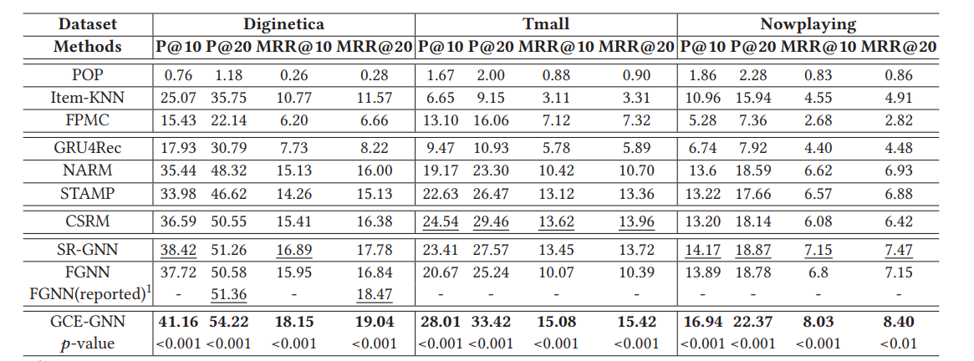
Experiments

Slide 11
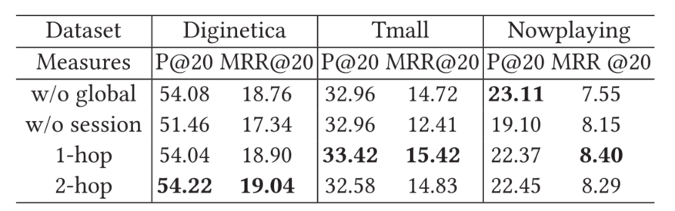
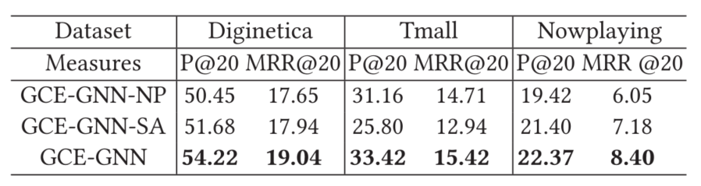
Experiments
Impact of Global Feature Encoder
Impact of Position Vector

Slide 12
Summary
The attention mechanism is used to adaptively select information related to the current conversation
Propose a position-aware attention to incorporate the reversed position information in item embedding.

